Slide 1
Object-oriented programming

Slide 2
Overview
Models and mimics real-world concepts through OOP elements
Tailored to the human mind rather than the machine
The focus is on the task for which the computer is used rather than the way a computer handles the task
Elements of OOP - classes, abstract classes, interfaces, objects, attributes, methods, etc.
Four major principles of OOP - abstraction, encapsulation, inheritance, polymorphism
More difficult than learning the Java programming language
Common mistake - procedural code masked in an object-oriented language

Slide 3
OOP model example
Stereo system:
Speakers - play mid-range and high-frequency sounds
Subwoofer - plays low bass frequency sounds
Tuner - receives radio broadcast signals
CD player - plays audio data from CDs
Key concepts:
The components are self-contained elements that perform a specific function
They can be combined and reused
They interconnect through standardized connectors

Slide 4
Objects and classes
Objects are software bundles of related state and behavior which model real-world objects.
A class is a template (blueprint) used to create objects.
Objects created from the same class have similar features.

Slide 5
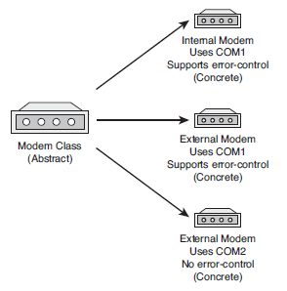
Example
A Modem class
Connects to a computer through a serial port
Can dial a phone number
Can send and receive data

Slide 6
Attributes and behavior
An object's state is expressed through attributes.
Attributes In Java are called variables.
Instance variables - object specific
Class (static) variables - class specific i.e. they relate to an entire class of objects created from a class
The behavior of an object relates to the things that the object can do to themselves and to other objects.
In Java behavior is expressed through methods.

Slide 7
Example: Volcano Robot svs-volcano-robot
A VolcanoRobot class used to do research inside volcanic craters.
Variables:
Status - Exploring, moving, returning home
Speed - Measured in kilometers per hour
Temperature - Measured in degrees centigrade
Methods:
Check current temperature
Begin a survey
Report current speed

Slide 8
Inheritance
Allows for one class, a subclass, to inherit the attributes and behavior of another class called a supperclass.
The subclass specifies how it differs from its supperclass.
Advantages:
Functionality common to multiple classes can be put into a superclass, which enables it to be used repeatedly in all classes below it in the hierarchy.
Changes to a superclass automatically are reflected in all its subclasses, their subclasses, and so on.

Slide 9
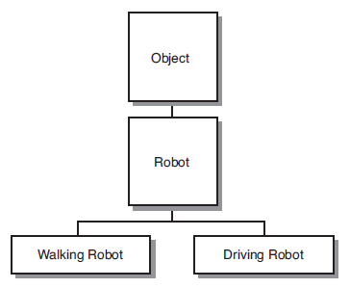
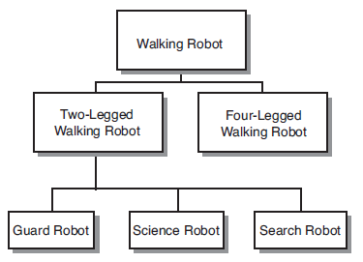
Class hierarchy example
Notes:
When creating an e.g. MarsRobot, it would be tempting to copy/paste the code from VolcanoRobot and modify it accordingly. However, later we might need a MoonRobot and if we proceed with the copy/paste way of doing things, it would be very hard to maintain the common code later on.

Slide 10
Inheritance in Java
One subclass can have only one superclass - single inheritance.
One superclass can have an unlimited number of subclasses.
If a class doesn't explicitly inherit from another class, it inherits implicitly from Java's Object class.

Slide 11
Exercises

Slide 12
Exercise: Volcano Robot Virgil svs-volcano-robot-virgil
In the main() method of the VolcanoRobot class, create a second VolcanoRobot robot named virgil, set up its instance variables, and display them.

